Slide 1



HackGPT
A contest for participants to utilize the ChatGPT API to develop innovative solutions for real-life problems.
Prepared By: Harsh Sinha
Student IITP, BSc CSDA 1st yr
Email: sinha.harsh12sep@gmail.com/harsh_2312res289@iitp.ac.in
Roll No: 2312res289

Slide 2



Equity Research Tool 📈 – Why the requirement?
Answering Questions related to Articles
Summarising the Article for quick Understanding
Saving Time

Slide 3
How it works?
Data – URL Loader loads the data
Vector DB (Data Base) - Database to store data as high-dimensional vectors
Prompt – A prompt is given by user as per requirements
LLM (Large Language Model) – The prompt and data is passed through LLM (GPT 3.5) to generate Output or Answer
Split – Text is split for proper reading and understanding on basis of tokens

Slide 4

About the project
The project is a user-friendly news research tool designed for effortless information retrieval. Users can input article URLs and ask questions to receive relevant insights from the stock market and financial domain.
Load URLs to fetch article content.
Article content is processed through LangChain's UnstructuredURL Loader
An embedding vector is constructed using OpenAI's embeddings and leverage FAISS, a powerful similarity search library, to enable swift and effective retrieval of relevant information
Interact with the LLM's (ChatGPT) by inputting queries and receiving answers along with source URLs.

Slide 5
Project Structure
HackGPT.ipynb: Script for the code without Streamlit for Checking
faiss_store_openai.pkl: A pickle file to store the FAISS index.
env: Configuration file for storing your OpenAI API key.
requirements.txt: A list of required Python packages for the project.
main.py: The main Streamlit application script.

Slide 6
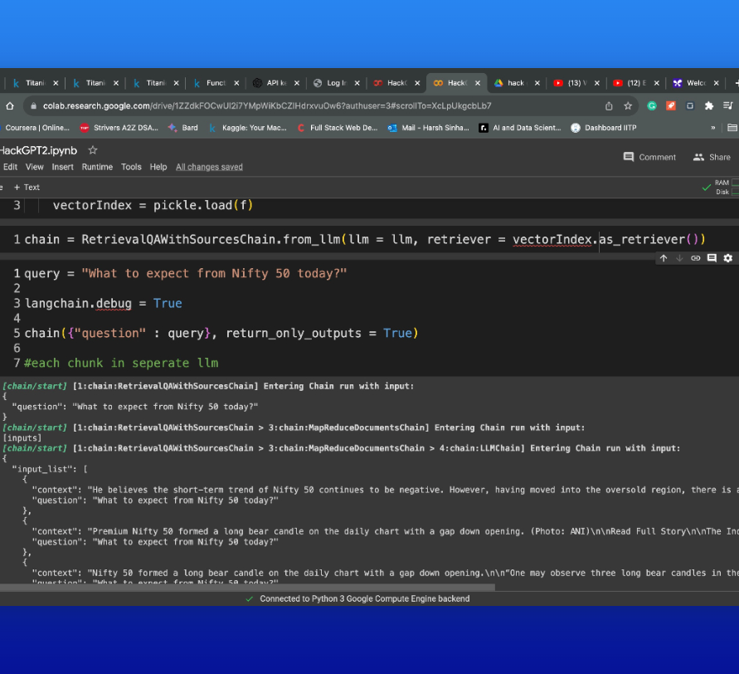
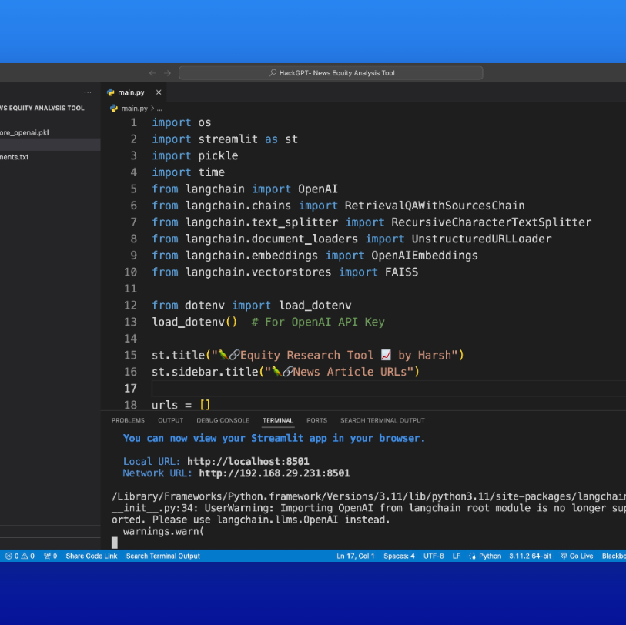
Implementation
Firstly the code was run and tested on a Google Colab Notebook without Streamlit.
It was then imported with required changes on VS Code for building and deploying the model on Streamlit.

Slide 7
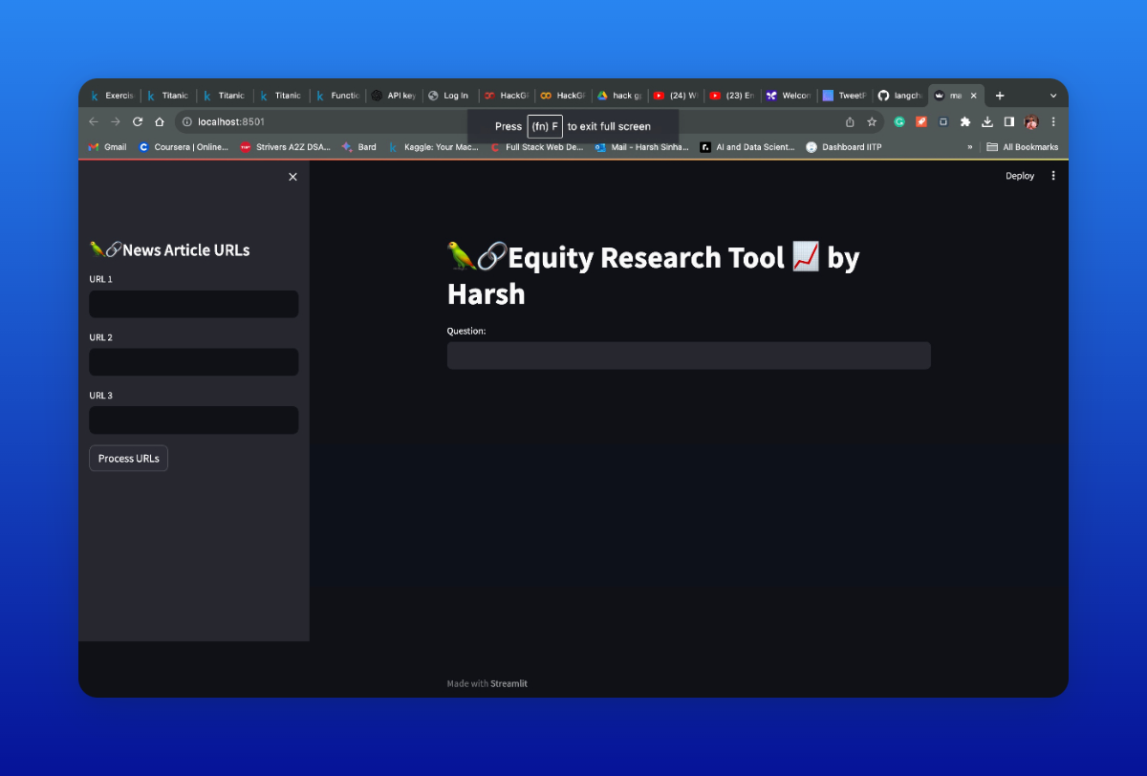
Final Implementation using Streamlit

Slide 8

GitHub Repository and other resource for Project
https://github.com/harshsinha-12/HackGPT
https://colab.research.google.com/drive/1ZZdkFOCwUl2i7YMpWiKbCZlHdrxvuOw6?usp=sharing

Slide 9

THANK YOU

